Slide 1
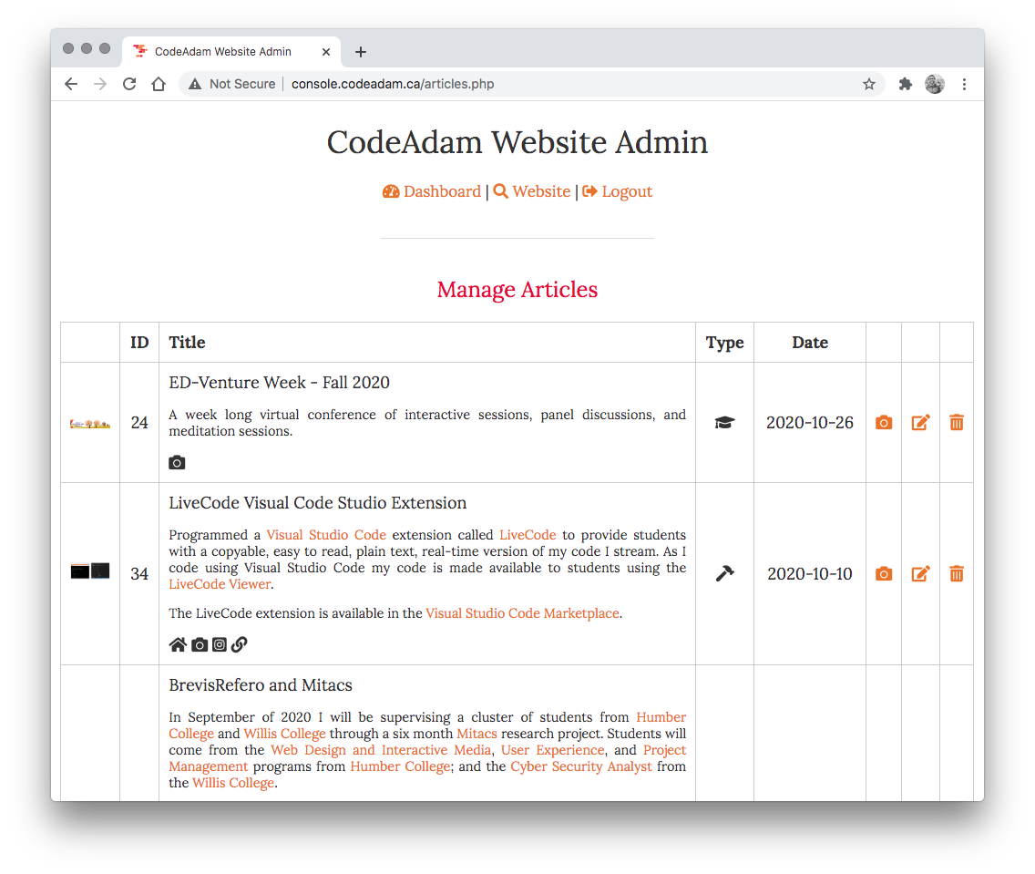
Building a CMS
We are going to build a basic CMS from scratch.
Our CMS will start with a tool to manage projects.

Slide 2
CRUD
LOGIN
The CMS will consist of the basic process to view, add, edit, and delete content, also known as CRUD.
C - Create R - Read U - Update D - Delete
DASHBOARD
MANAGE ARTICLES
ADD ARTICLE
EDIT ARTICLE
DELETE ARTICLE

Slide 3
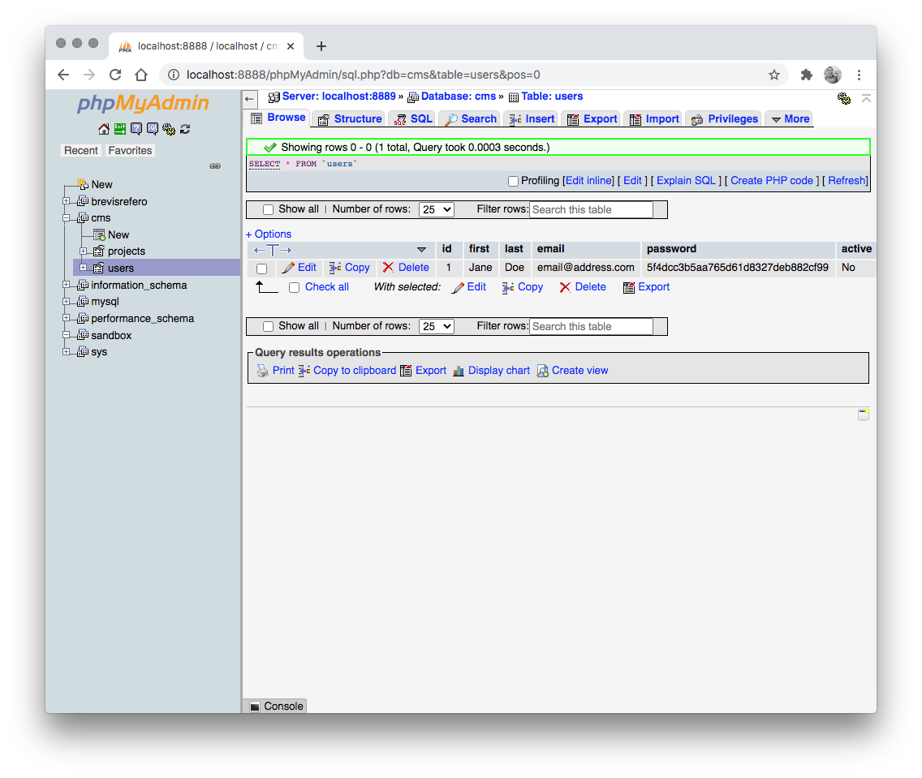
1: Database
We will start by creating a table to store admin accounts and projects:

Slide 4
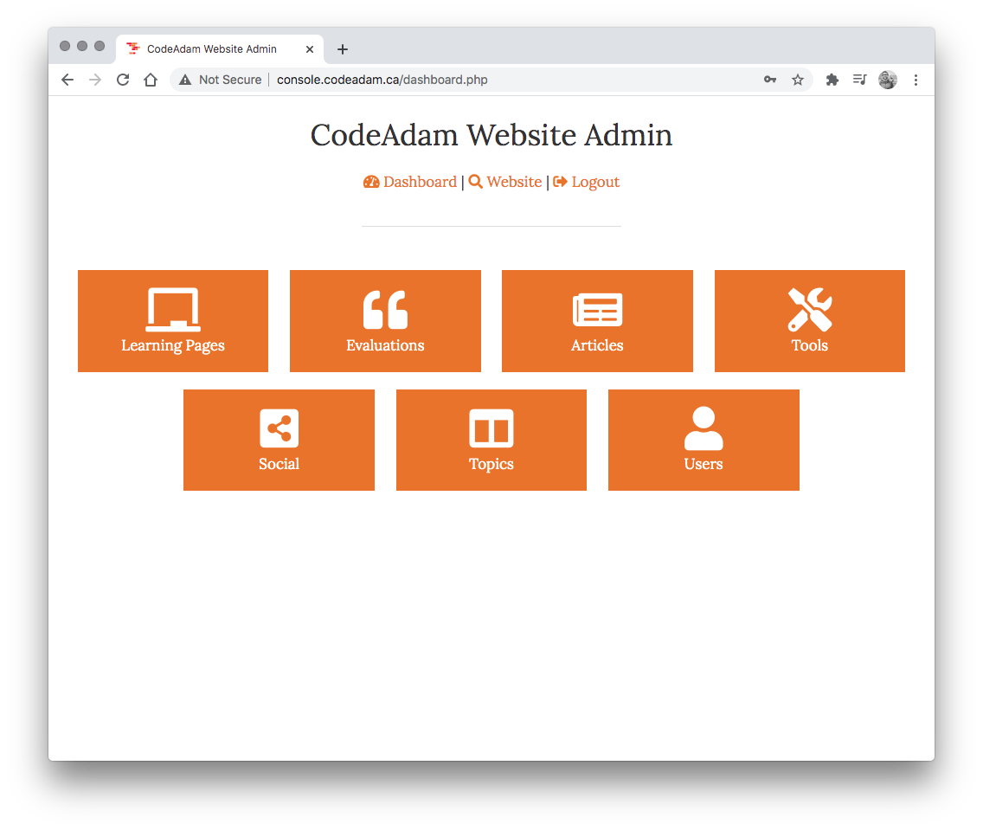
2: Dashboard
Next we will create a dashboard.
The dashboard will prevent access if the user has not logged in.

Slide 5
2: Dashboard
Possible modules:
Projects Employment Education Skills/Topics/Languages Contact Form Social Media

Slide 6
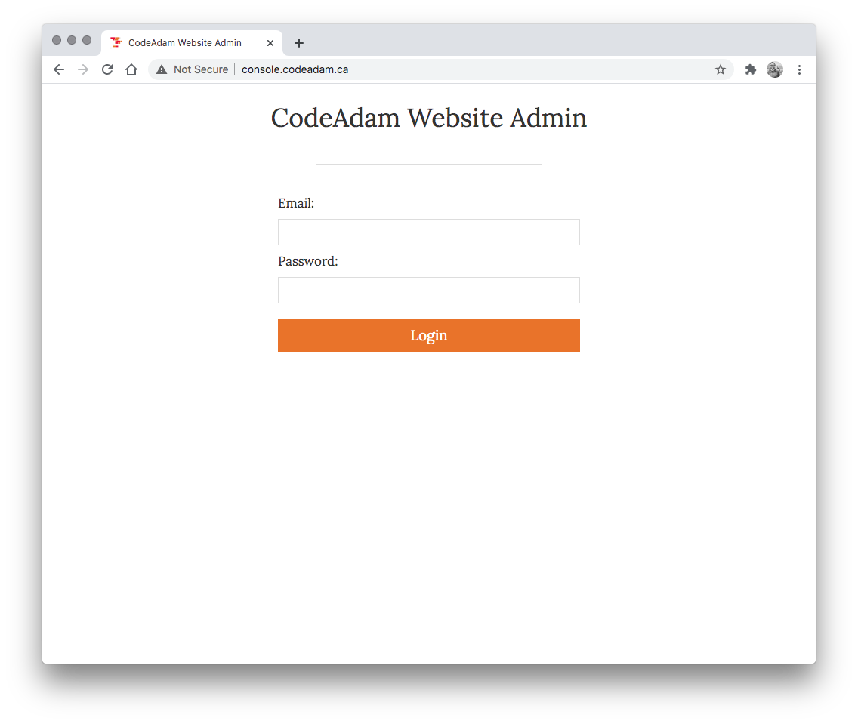
3: Login
We will use a basic login process using md5 and a session.

Slide 7
Clone this Repo
https://github.com/codeadamca/php-cms

Slide 8
Goals this Week
1. Work on your final assignment

Slide 9
Add New Content
1. Add /admin to the URL 2. Log in with email@address.com and password
3. Add some new content!

